Slide 1
Introduction to Computing
for the Social Sciences
Session 2 - Information Coding
David Garcia
Winter Semester 2024-25

Slide 2
Course Outline
Session 1: Introduction
Session 2: Information Coding
Session 3: Data Structures
Session 4: Programming
Session 5: Algorithms
Session 6: Recursion
Session 7: Sorting Algorithms
Session 8: Time Complexity
Session 9: Formal Languages and Automata
Session 10: Turing Machines and Complexity Classes
Session 11: Databases
Session 12: Parallel Programming
Session 13: Social Science Applications
Session 14: Exam Review

Slide 3
Outline
Information Coding
Conversion Between Number Coding Systems
Character Coding

Slide 4

What is information?
In Computer Science, information is the representation of knowledge

Slide 5

Measuring information
Information can be empirically measured as changes in knowledge.
For example, what we learn from the answer to a question
Is it heads?
no
yes

Slide 6
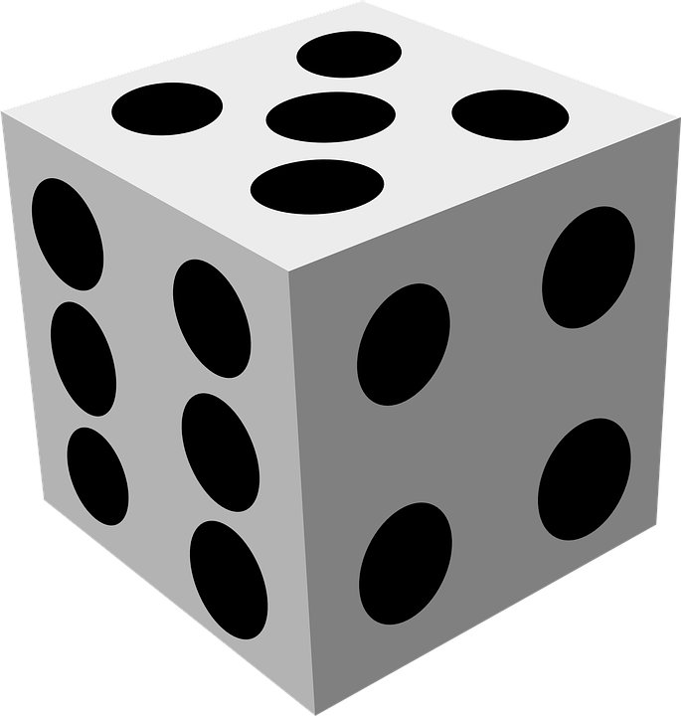
Measuring information in bits
Each yes/no question gives us a bit of information.
How many bits do we learn from the result of a dice throw?
6?
no
yes
5?
6
no
yes
4?
5
no
yes
3?
4
no
yes
2?
3
no
yes
1
2

Slide 7
Measuring information in bits
Each yes/no question gives us a bit of information.
How many bits do we learn from the result of a dice throw?
6?
no
yes
5?
6
no
yes
4?
5
no
yes
3?
4
no
yes
2?
3
no
yes
1
2
On average we will need to ask 20/6 questions (3.33). Can we do better?

Slide 8
Measuring information better
<4?
no
yes
4?
3?
yes
no
yes
no
5?
4
2?
3
no
yes
yes
no
6
5
1
2
This way we only need 16/6 questions on average (2.66)
Each yes/no question doubles the number of possibilities,
e.g. a result with 8 equally likely possibilities has 3 bits of information

Slide 9
Representing Information
<4?
no=0
yes=1
4?
3?
no=0
yes=1
no=0
yes=1
5?
4=01
2?
3=11
no=0
yes=1
no=0
yes=1
6=000
5=001
1=100
2=101
Encoding the result of a dice (1-6) with three bits (0 or 1)
Prefix code: no coding is a prefix of another, allows unambiguous encoding

Slide 10
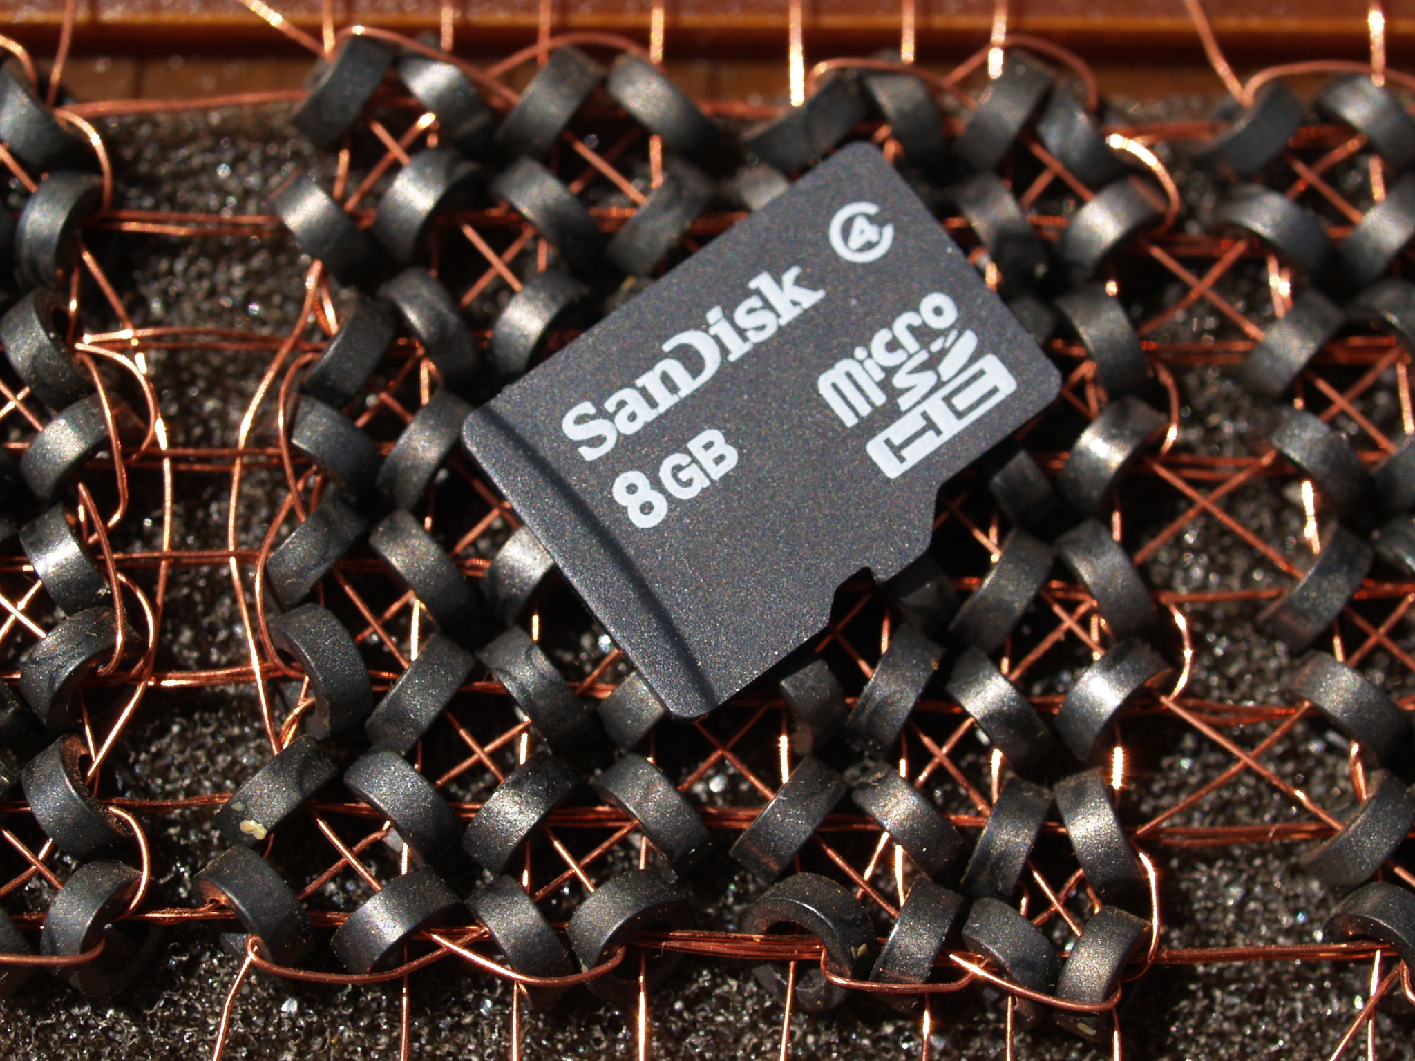
Storing information
Smallest physical information unit is 1 bit
no/yes is represented as 0/1
memory: a capacitor or a capacitor and several transistors
hard disk: magnetization
Smallest logical unit is 1 byte: 8 bit
processors can usually only address entire bytes, i.e. information in chunks of 8 bits

Slide 11
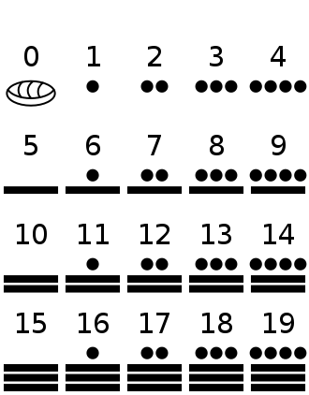
Positional number systems
Value of digit depends on its position
Composed of a finite number of numeric symbols (a.k.a. alphabet)
Each position represents a specific value base^{k} (base³ base² base¹ base⁰ )
Examples:
Decimal number system:
In 12, digit 1 has value 10
in 1200 digit 1 has value 1000
Unary number system: to represent number N, an arbitrary symbol representing 1 is repeated N times
Positional number systems require a symbol for zero.
e.g the Maya number system is a base-20 positional number system
https://en.wikipedia.org/wiki/Maya_numerals
https://en.wikipedia.org/wiki/Roman_numerals

Slide 12
The base of a positional number system
Base is also often referred to as radix
base 10: decimal notation (0 – 9)
base 2: binary notation (0, 1)
base 8: octal notation (0 – 7)
base 16: hexadecimal notation (0 – 9, A – F)
Notation convention is to indicate the base, if not clearly known, as subscript
7₁₀ = 7₈ = 111₂
9₁₀ = 11₈ = 1001₂
14₁₀ = 16₈ = 1110₂

Slide 13
Conversion Between Number Coding Systems
Information Coding
Conversion Between Number Coding Systems
Character Coding

Slide 14
Conversions Between Number Systems
Which is greater: 47₈ or 43₁₀ ?

Slide 15
Conversions Between Number Systems
Which is greater: 47₈ or 43₁₀ ?
Convert from octal to decimal notation
47₈ = 7 × 8⁰ + 4 × 8¹ = 39₁₀

Slide 16
Conversions Between Number Systems
Which is greater: 47₈ or 43₁₀ ?
Convert from decimal to octal notation
43₁₀ = 3 × 8⁰ + 5 × 8¹ = 53₈

Slide 17
Examples
Decimal notation
5648₁₀ = 8 × 10⁰ + 4 × 10¹ + 6 × 10² + 5 × 10³
Octal to decimal
1346₈ = 6 × 8⁰ + 4 × 8¹ + 3 × 8² + 1 × 8³ = 742₁₀
Hexadecimal to decimal
CB6₁₆ = 6 × 16⁰ + 11 × 16¹ + 12 × 16² = 3 254₁₀

Slide 18
Conversions Between Number Systems
Conversion of octal to binary notation
every digit 0 – 7 can be represented exactly by 3 binary digits
allows for elegant and fast conversion digit by digit using blocks of 3 binary digits
Examples
47₈ = 39₁₀ = ?₂

Slide 19
Conversions Between Number Systems
Conversion of octal to binary notation
every digit 0 – 7 can be represented exactly by 3 binary digits
allows for elegant and fast conversion digit by digit using blocks of 3 binary digits
Examples
47₈ = 39₁₀ = 1 × 2⁰ + 1 × 2¹ + 1 × 2² + 0 × 2³ + 0 × 2⁴ + 1 × 2⁵ = 100 111₂

Slide 20
Conversions Between Number Systems
Conversion of octal to binary notation
every digit 0 – 7 can be represented exactly by 3 binary digits
allows for elegant and fast conversion digit by digit using blocks of 3 binary digits
Examples
47₈ = 100 111₂
134₈ = ?₂
460231₈ = ?₂
Oct | 0 | 1 | 2 | 3 | 4 | 5 | 6 | 7
Binary | 000 | 001 | 010 | 011 | 100 | 101 | 110 | 111

Slide 21
Conversions Between Number Systems
Conversion of octal to binary notation
every digit 0 – 7 can be represented exactly by 3 binary digits
allows for elegant and fast conversion digit by digit using blocks of 3 binary digits
Examples
47₈ = 100 111₂
134₈ = 001 011 100₂
460231₈ = ?₂
Oct | 0 | 1 | 2 | 3 | 4 | 5 | 6 | 7
Binary | 000 | 001 | 010 | 011 | 100 | 101 | 110 | 111

Slide 22
Conversions Between Number Systems
Conversion of octal to binary notation
every digit 0 – 7 can be represented exactly by 3 binary digits
allows for elegant and fast conversion digit by digit using blocks of 3 binary digits
Examples
47₈ = 100 111₂
134₈ = 001 011 100₂
460231₈ = 100 110 000 010 011 001₂
Oct | 0 | 1 | 2 | 3 | 4 | 5 | 6 | 7
Binary | 000 | 001 | 010 | 011 | 100 | 101 | 110 | 111

Slide 23
Conversions Between Number Systems
Conversion of binary to octal notation
divide binary digits into groups of three bits and convert each group of bits to octal digit
Examples
101 011₂ = 53₈
010 011 100 101 111₂ = 23457₈
Oct | 0 | 1 | 2 | 3 | 4 | 5 | 6 | 7
Binary | 000 | 001 | 010 | 011 | 100 | 101 | 110 | 111

Slide 24
Conversions Between Number Systems
Conversion of hexadecimal to binary notation
every digit 0 – 9 and letters A – F can be represented by exactly 4 binary digits
allows for elegant and fast conversion digit by digit using blocks of 4 binary digits
Examples
23A7₁₆ = 0010 0011 1010 0111₂
B3D2₁₆ = 1011 0011 1101 0010₂
Hex | 0 | 1 | 2 | 3 | 4 | 5 | 6 | 7 | 8 | 9 | A | B | C | D | E | F
Binary | 0000 | 0001 | 0010 | 0011 | 0100 | 0101 | 0110 | 0111 | 1000 | 1001 | 1010 | 1011 | 1100 | 1101 | 1110 | 1111

Slide 25
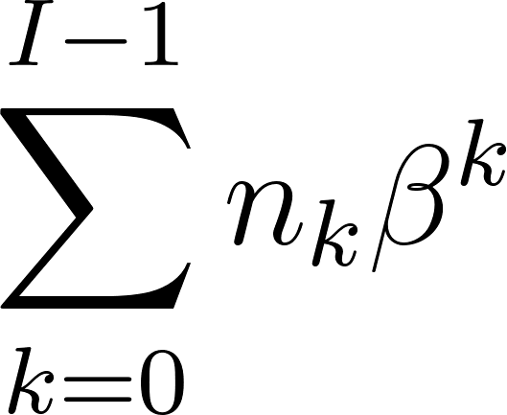
Conversions Between Number Systems
Conversion of a binary number n≥0 with I digits to decimal notation (default)
number n with I=4 is written as n₃ n₂ n₁ n₀
Generalized notation for non-negative binary number with
I digits and base β:
Procedure ConvertBinaryToDecimal(B)
Inputs:
B: binary number with l digits written as n_{l} … n₂ n₁ n₀
Result: decimal number
sum ←0
For k = 0 to l-1:
sum ← sum + n_{k} × 2^{k}

Slide 26
Conversions Between Number Systems
Example
Conversion of a decimal number n≥0 to binary notation
Quotient Rest
190 : 2 = 95 0
95 : 2 = 47 1
47 : 2 = 23 1
23 : 2 = 11 1
11 : 2 = 5 1
5 : 2 = 2 1
2 : 2 = 1 0
1 : 2 = 0 1
Procedure ConvertDecimalToBinary(n)
Inputs:
n: positive number encoded in decimal
Result: binary number with l digits written as x_{l} … n₂ n₁ n₀
k ←0 While n > 0:
x_{k} ← n mod 2
n ←⌊n/2⌋
k ← k+1
return x_{k} … x₀
190₁₀ = 1011 1110₂

Slide 27
Conversions Between Number Systems
Generalization: conversion of a decimal number n≥0 to base-β notation
Procedure ConvertDecimalToBetaBase(n)
Inputs:
n: positive number encoded in decimal
Result: number in base β with l digits written as x_{l} … n₁ n₀
k ←0 While n > 0:
x_{k} ← n mod β
n ←⌊n/β⌋
k ← k+1
return x_{k} … x₀

Slide 28
Conversions Between Number Systems
Conversion of number n with only decimal places to binary notation
notation of binary number with decimal places is 0.x₋₁ x₋₂… x_{-k}
Procedure ConvertOnlyDecimalToBinary(n)
Inputs:
n: positive number n encoded in decimal; 0<n<1
Result: binary number with l digits written as 0.x₋₁ x₋₂ … x_{-k}
k ←-1 While n > 0:
x_{k} ← ⌊n × 2⌋
n ←n × 2 - x_{k}
k ← k-1
return 0.x₋₁ x₋₂ … x_{-k}
Example:
0,34375 x 2 = 0,6875 Value 0
0,6875 x 2 = 1,375 Value 1
0,375 x 2 = 0,75 Value 0
0,75 x 2 = 1,5 Value 1
0,5 x 2 = 1,0 Value 1
(0,34375) ₍₁₀₎ =(0,01011) ₍₂₎

Slide 29
Negative Numbers
Ones’ Complement
leading bit codes the sign (0: +, 1: – )
k-1 digits to represent the absolute value of a given number
negation by inverting of the number
bit-wise flipping of 1s and 0s
Problem: there are two representations of 0:
0000 0000
1111 1111
Example
27₁₀ = 0001 1011₂
-27₁₀ = 1110 0100₂

Slide 30
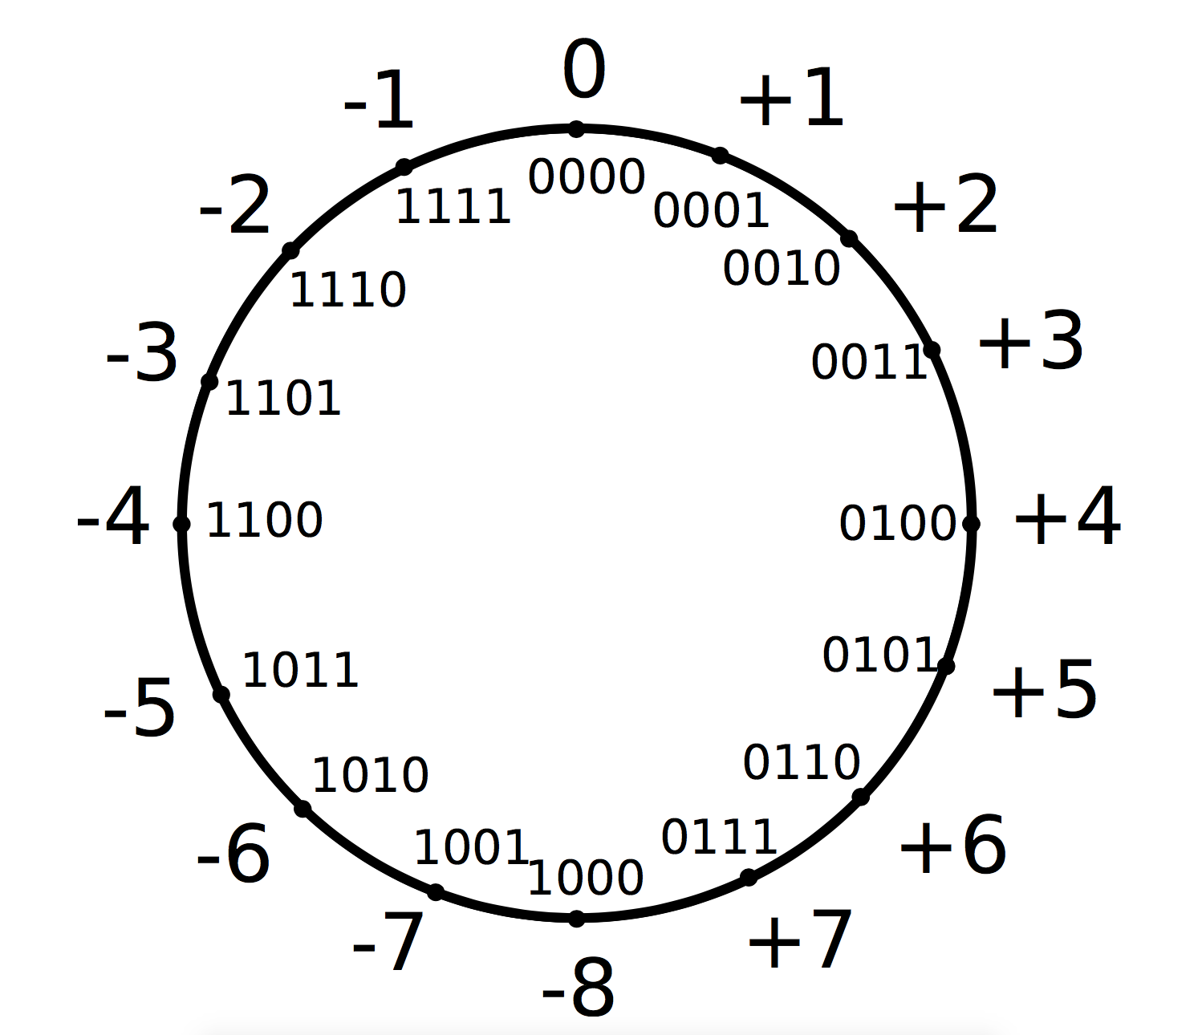
Negative Numbers
Two’s Complement
leading bit codes the sign (0: +, 1: – )
negation by inverting of the number and adding 1
unique representation of 0: 0000 0000
Example
27₁₀ = 0001 1011₂
1110 0100₂ (inverted)
1110 0101₂ = – 27₁₀

Slide 31
IEEE 754
Standardized according to IEEE 754:
single or double precision (32 or 64 bit, float or double)
1 bit for the sign of mantissa: s = -1^{S}
8/11 bit biased exponent: e = E - B
bias permits to have a longer range of negative exponents
B=127 or B=1023
23/52 bit normalized mantissa with implicit 1: m= 1.M
leading 1 is not explicitly stored
mantissa and exponent are adjusted accordingly (normalized)

Slide 32
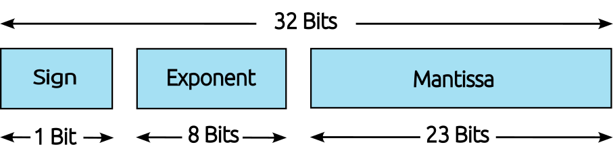
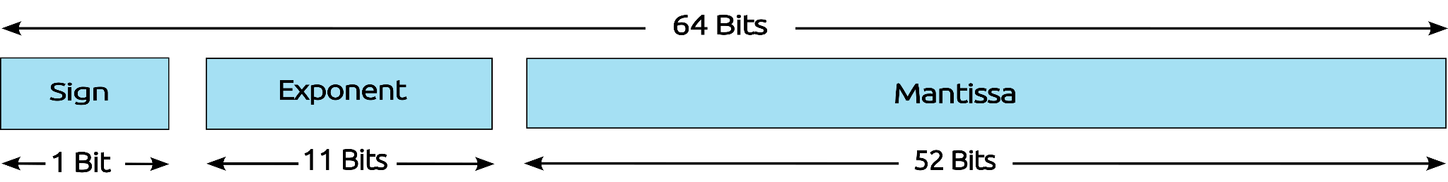
IEEE 754
Standardized according to IEEE 754:
single or double precision (32 or 64 bit, float or double)
1 bit for the sign of mantissa: s = -1^{S}
8/11 bit biased exponent: e = E - B
23/52 bit normalized mantissa with implicit 1: m= 1.M
Single Precision
IEEE 754 Floating-Point Standard
Double Precision
IEEE 754 Floating-Point Standard

Slide 33
IEEE 754
Single Precision
IEEE 754 Floating-Point Standard
Double Precision
IEEE 754 Floating-Point Standard
Special representation for
0 : exponent and mantissa are both 0
there is a positive and negative 0
infinity : exponent E only 1s, mantissa M=0
Value ranges: simple precision: 1.4 ∙ 10⁻⁴⁵ ≤ |z| ≤ 3.4 ∙ 10³⁸ double precision: 4.9 ∙ 10⁻³²⁴ ≤ |z| ≤ 1.7 ∙ 10³⁰⁸

Slide 34
IEEE 754
Example: Decimal value to float value
18.625 in single precision
bias B = 127 = 2⁷ -1
transform to binary notation: 18.625₁₀ = 10010.101000…₂
normalize to calculate exponent: 10010.101000…₂ = 1.0010101000… ∙ 2⁴
exponent with bias: E = 4₁₀ + 127₁₀ = 131₁₀ = 1000 0011₂
sign S = 0
result: 0|10000011|00101010000000000000000

Slide 35
IEEE 754
Example: Float value to decimal value
1|10010011|10100000000000000000000 in single precision
sign S = 1, i.e., a negative number
exponent E = 147 = 127 + 20, i.e., e = 20
mantissa m = 1 + 1 ∙ 2⁻¹ + 1 ∙ 2⁻³ = 1.625
result - 1.625 ∙ 2²⁰ = - 1 703 946.0

Slide 36
Problems with Number Coding
Limited value range
can not represent every possible number
in practice double precision does cover most cases though
Limited precision, rounding errors
limited room for decimal places
certain decimal numbers can not be expressed precisely in binary notation:
very common example: 0.1
accumulation of small rounding errors possible
Example (in Python)
1 f = 2
2 for i in range(1, 100):
3 f += 10 ** (-1)
print(f)
>> 2.1
>> 2.2
>> 2.3000000000000003
>> 2.4000000000000004

Slide 37
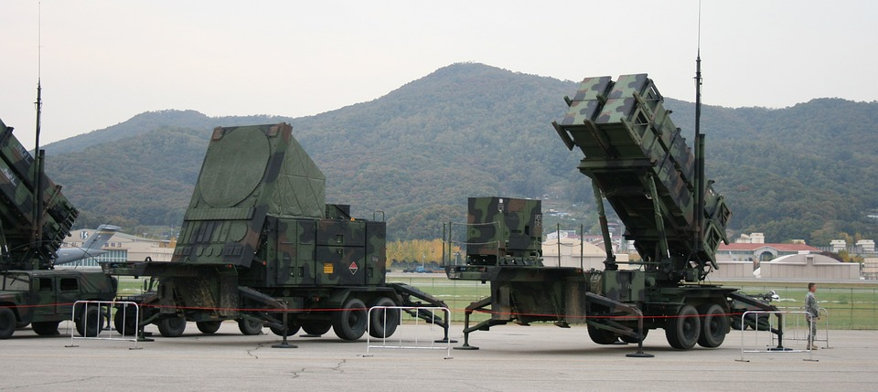
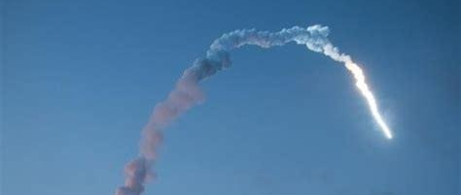
Rounding and floating point errors
Gulf War, 1991: Iraqi Scud missile hit American barracks in Dhahran, Saudi Arabia, killing 28 soldiers and wounding 260.
“A 24-bit representation of 0.1 was used to multiply the clocktime, yielding a result in a pair of 24-bit registers. This was transformed into a 48-bit floating-point number.”
"Roundoff Error and the Patriot Missile", Robert Skeel, SIAM News (1992)
Ariane 5 maiden flight, 1996: Rocket exploded 39 seconds after liftoff.
Error when converting horizontal velocity from a 64-bit floating point number to a 16-bit signed integer between the software of Ariane 5 and Ariane 4.
N° 33–1996: Ariane 501 - Presentation of Inquiry Board report

Slide 38
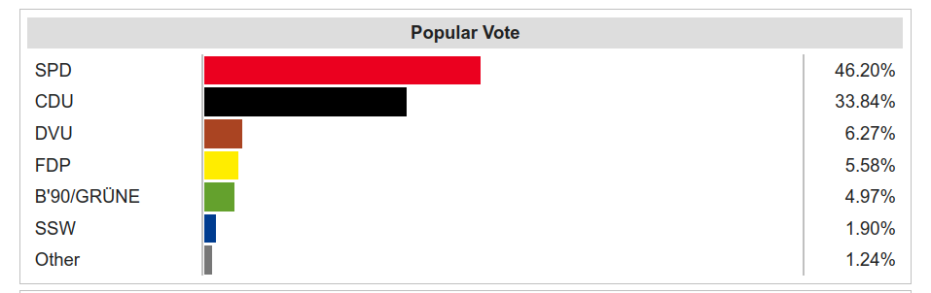
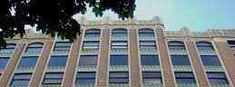
Numeric precision in the social sciences
1983: the Vancouver Stock Exchange index loses 50% value in two years for no apparent economic reason.
“It began with a nominal value of 1,000.000 and was recalculated after each recorded transaction by calculation to four decimal places, the last place being truncated so that three decimal places were reported. “
“The Numerical Reliability of Econometric Software”. McCullough & Vinod, Journal of Economic Literature (1999)
April 1992 elections in the state of Schleswig-Holstein: The Green Party has a result very close to the 5% threshold
Rounding error when printing election results showed 5% for green party when it had 4.97% of the vote. Error would have taken away majority from SPD
“Rounding error changes Parliament makeup”. Debora Weber-Wulff, The Risks Digest (1992)

Slide 39
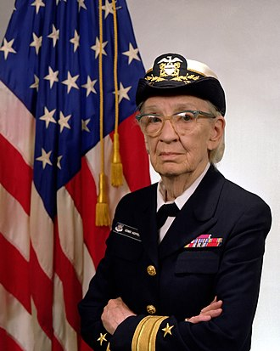
COBOL and Grace Hopper
COBOL is a very old programming language developed in the 1960s but still very used in banking, finance, and government
COBOL does no rounding by default on fractions, minimizing the risk of rounding errors
Grace Hopper, a.k.a. grandma COBOL, was an American military computer scientist that invented machine-independent programming languages, COBOL being one of the first
https://www.tpr.org/technology-entrepreneurship/2019-05-23/how-cobol-still-powers-the-global-economy-at-60-years-old

Slide 40
Character Coding
Information Coding
Conversion Between Number Coding Systems
Character Coding

Slide 41
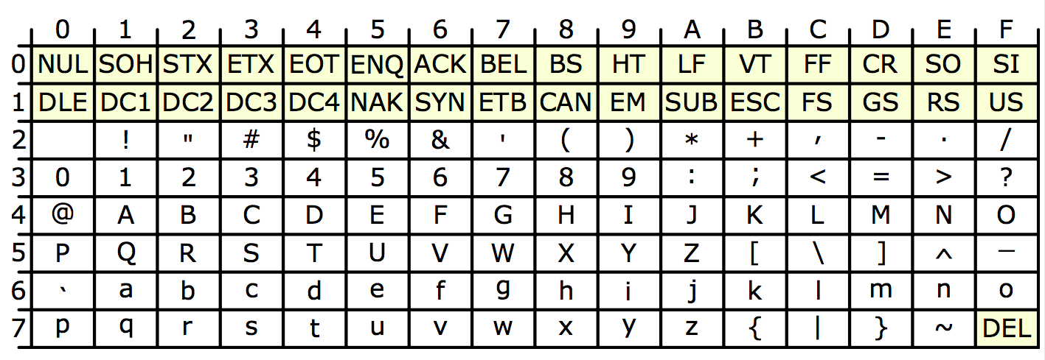
ASCII – Code
American Standard Code for information interchange
Standard since 1963, still in use today
initially 7 bit code for tele printers, all codes of US keyboard in one byte
128 characters, 33 control characters, 95 printable characters
Missing characters for other keyboards

Slide 42
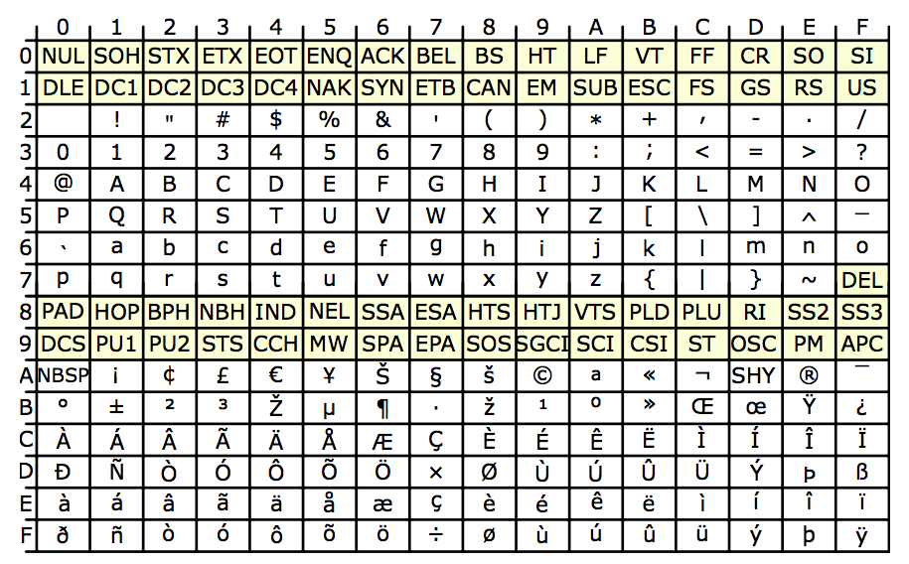
Code Pages
Extension of ASCII-Codes to 8 bit (1 byte)
CP850, CP437, IS0-8859-1 to ISO-8859-15 with characters for other languages

Slide 43
Unicode
Addresses problems with ASCII and code pages
not all possible characters can be represented, e.g., kanji, chinese
meaning of a code is dependent on code page, therefore frequent confusion
Development of standardized Unicode
simultaneous representation of all possible characters
fixed translation table
version 1.0 in 1991 with 65 536 different characters
2022 version (15.0) has 149,186 characters

Slide 44
Unicode
Division of full code space into 17 planes each with 65 536 characters
specification using plane U+ and at least 4 hexadecimal numbers
one code correspond to exactly one character
e.g.: U+00DF = ß
3 Bytes per code
Plane 0, Basic Multilingual Plane (BMP)
currently used character sets, punctuation marks, control characters etc.
highly fragmented and mostly occupied
Plane 2, Supplementary Ideographic Plane (SIP)
Chinese, Japanese and Korean characters

Slide 45
Representation of Unicode
3 bytes are necessary for all possible characters
wasting memory in many geographical regions, e.g. Europe
Definition of Unicode Transformation Formats (UTF) as solution
UTF-16
2 byte per characters but still wastes memory
other areas are covered by combination of UTF-16 characters
UTF-8
1 byte per character, covers most important Western characters
Compatible with ASCII Codes
additional characters can be covered by a combination of up to three UTF-8 characters

Slide 46
Usual Character Encoding Issues
Character encoding is a usual source of problems with social science data
Try to control coding in documentation and keep it general (e.g. UTF-8)
>>> u = chr(40960) + u'abcd' + chr(1972)
>>> u.encode('utf-8')
'\xea\x80\x80abcd\xde\xb4'
>>> u.encode('ascii')
Traceback (most recent call last):
File "<stdin>", line 1, in ?
UnicodeEncodeError: 'ascii' codec can't encode character '\ua000' in position 0: ordinal not in range(128)
>>> u.encode('ascii', 'ignore')
'abcd'
>>> u.encode('ascii', 'replace')
'?abcd?'
>>> u.encode('ascii', 'xmlcharrefreplace')
'&#40960;abcd&#1972;'

Slide 47
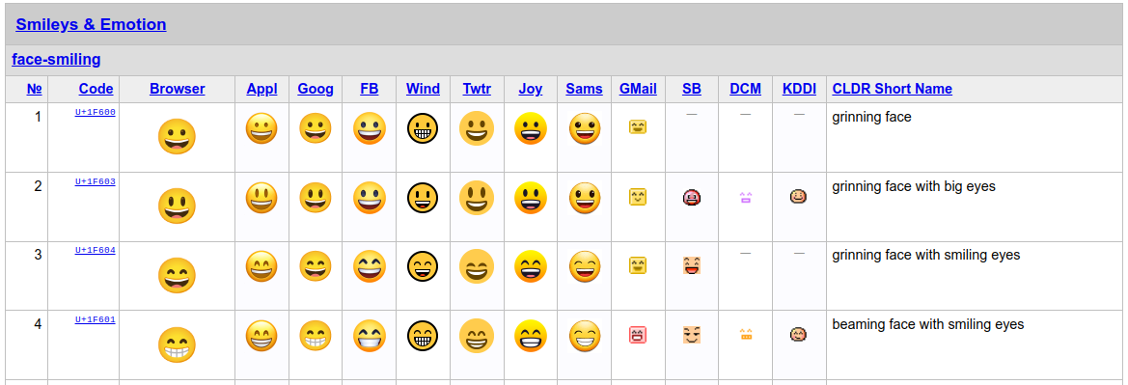
Encoding Emoji

Slide 48
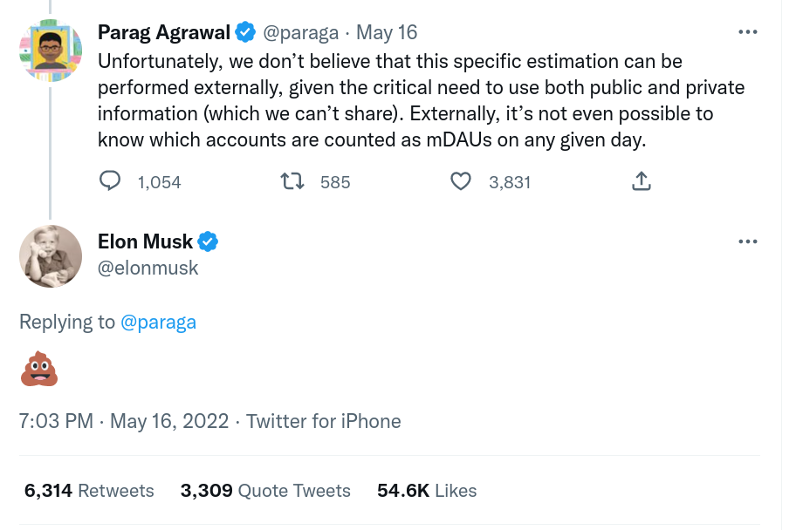
Encoding Emoji
Started as emoticons (e.g. :)) in the 1980s
Included in the early 2000s in chat software, standard unicode since v6.0 (2010)
2015: Oxford Dictionary word of the year is the Face with Tears of Joy emoji (😂)
Visualization depends on software similarly to how fonts change alphabetic characters
Currently allow skin color or gender
modifiers by concatenating emoji
characters

Slide 49
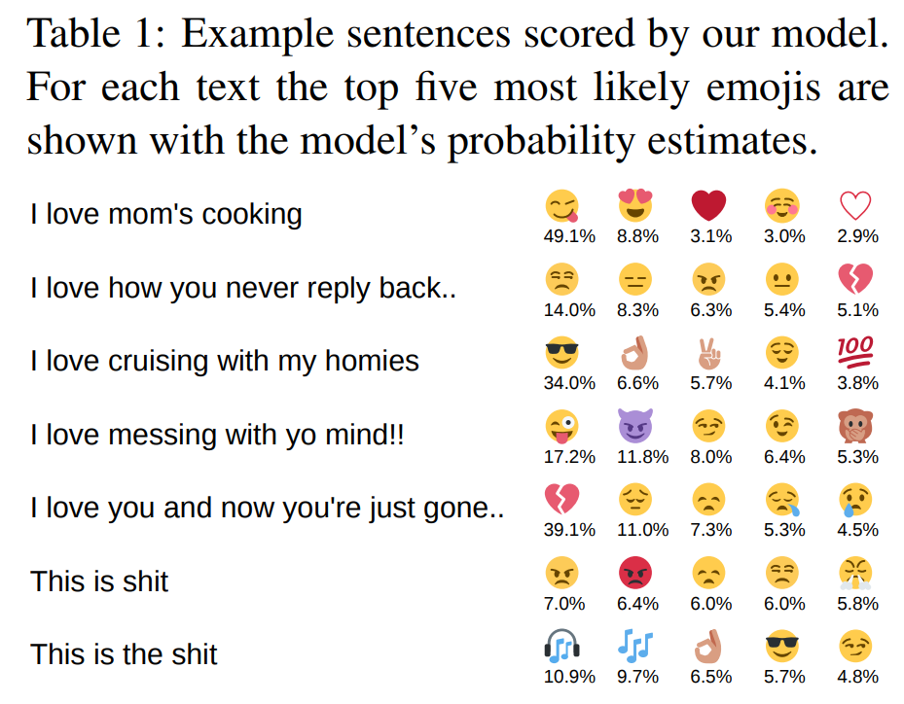
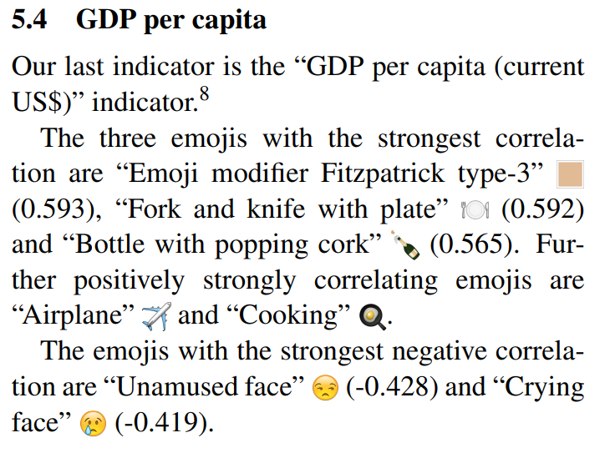
Emoji Research
A global analysis of emoji usage. Ljubešić & Fišer. Proceedings of the 10th web as corpus workshop (2016)
Using millions of emoji occurrences to learn any-domain representations for detecting sentiment, emotion and sarcasm. Felbo et al. Proceedings of the 2017 Conference on Empirical Methods in Natural Language Processing (2017)

Slide 50
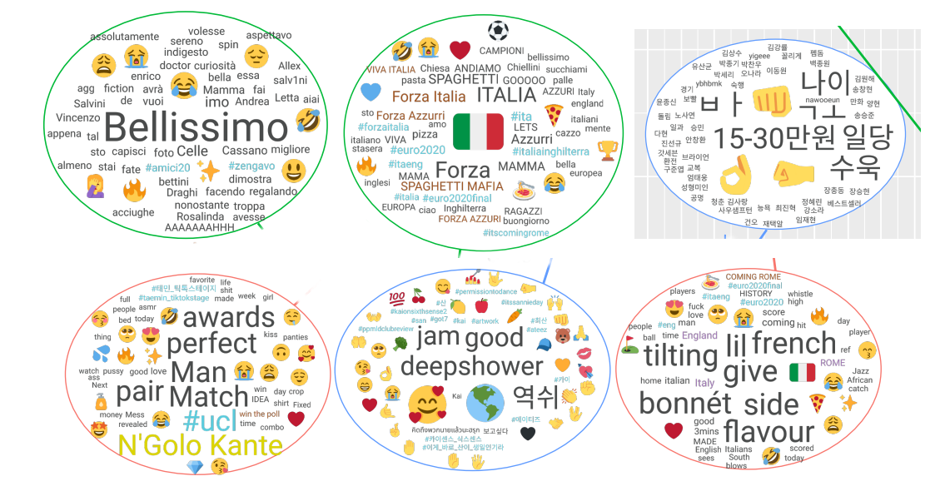
Emoji Research
🤌 and its meanings: An emojical study. Anna Di Natale, Emma Fraxanet, Max Pellert, Jana Lasser, Hannah Metzler, Alina Herderich, Segun Aroyehun, Apeksha Shetty, David Garcia. Holiday Paper Series 2021

Slide 51
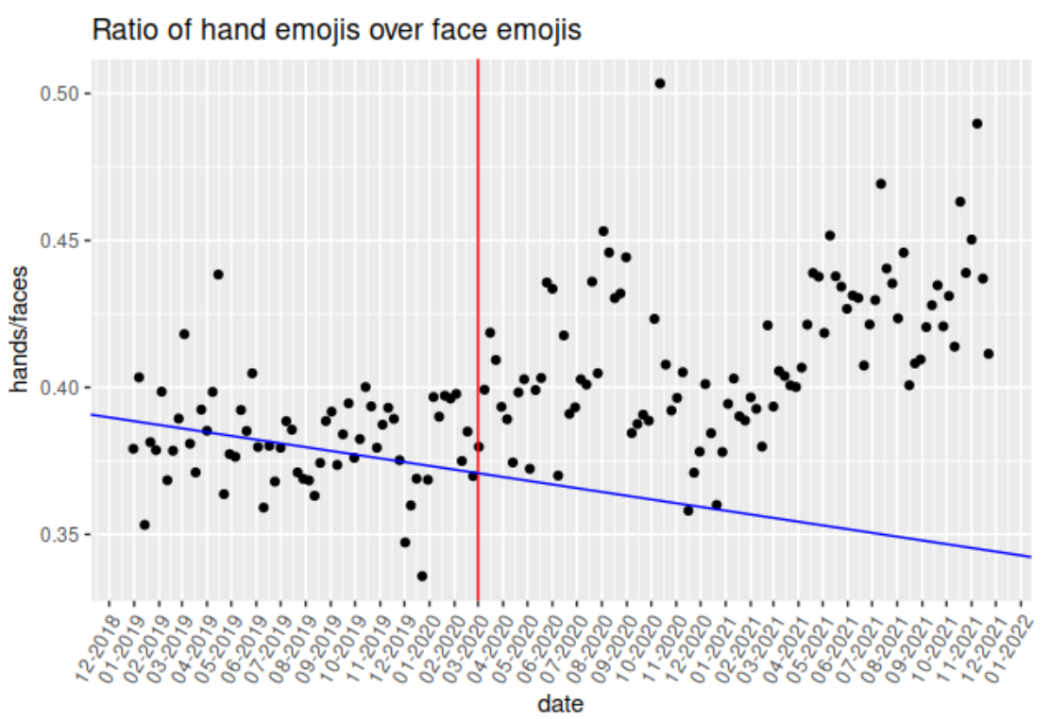
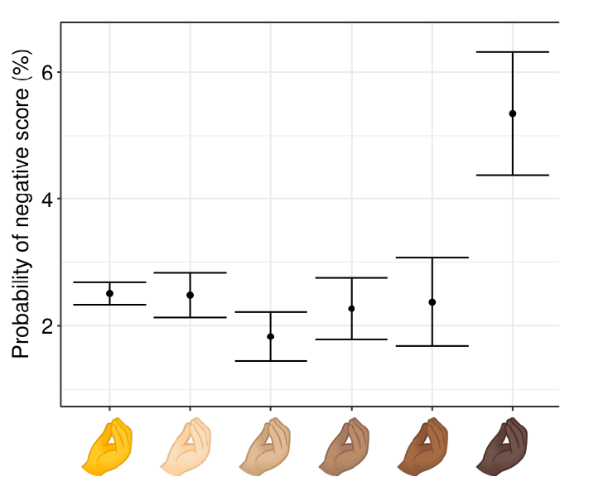
Emoji Research
🤌 and its meanings: An emojical study. Anna Di Natale, Emma Fraxanet, Max Pellert, Jana Lasser, Hannah Metzler, Alina Herderich, Segun Aroyehun, Apeksha Shetty, David Garcia. Holiday Paper Series 2021

Slide 52
Next Session
Data Structures
data types
arrays
linked lists
binary search trees
hash tables
graphs

Slide 53
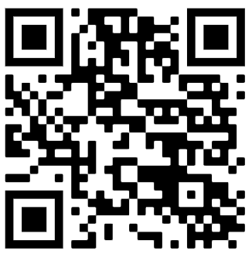
SEDS admitted students survey
Survey for all SEDS applicants (who came and who did not)
Please help us understanding what attracted you to the program!
https://forms.gle/kziuZGsMTAVsKtZz7

